Slide 1
AI ENGINEER AND BUILDER
Trevor Grafton
Voice agents, local agent teams, ML and games.
~$20K/yr projected savings from Alex, a phone agent that files real tickets.
1 / 16

Slide 2
COMPUTER SCIENCE STUDENT WITH A SERVICE DESK
Who I am
BS Computer Science, Wentworth Institute of Technology, expected May 2027.
Service Desk Analyst Co-op, then part-time IT Specialist, at BXP.
I build AI systems where small action surfaces and measured costs matter.
2 / 16

Slide 3
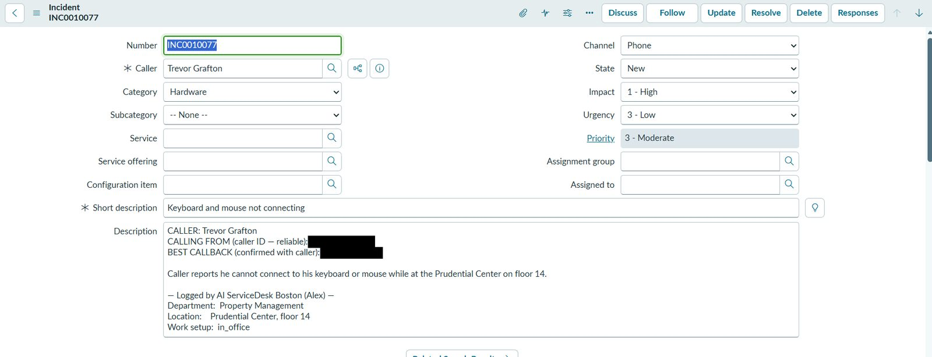
THE PROBLEM
Alex: a phone line that files tickets
Routine service-desk calls tie up staff who should be solving hard cases.
Alex answers a real phone number, says it is an AI, and gathers the details.
When the call ends, plain Python files a complete incident in ServiceNow.
Alex answers up to three calls at once, with overflow to the help desk.
ServiceNow incident Alex filed from a test call: a keyboard and mouse hardware issue with impact and urgency set, caller ID and callback numbers blacked out
3 / 16

Slide 4
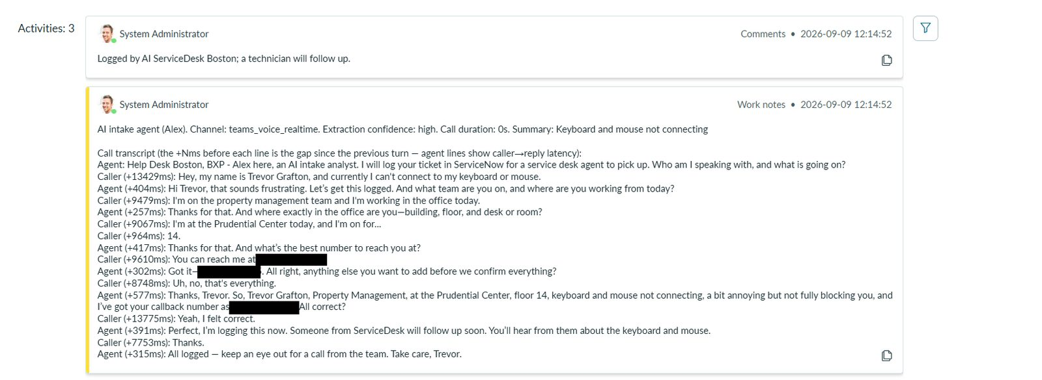
ARCHITECTURE
Alex: how a call becomes a ticket
Step | What happens
Caller dials in | Azure Communication Services answers the call
Live conversation | Azure OpenAI Realtime (gpt-realtime-2.1-mini), speech to speech
Caller hangs up | gpt-5-mini, with no tools, extracts the ticket fields from the transcript
Ticket filed | Plain Python creates the incident through the ServiceNow Table API
Work notes on the same incident: the call transcript with each reply's latency in milliseconds, callback number blacked out
4 / 16

Slide 5
SECURITY
Alex: a jailbreak has nothing to reach
The action surface is 3 verbs: talk, transfer to a human, hang up.
906 automated tests in the Alex repository.
The live model has no ServiceNow tools; the post-call model has no tools at all.
ServiceNow access is narrow: Python files the ticket after the call; the one read is a verified caller's own ticket status.
Credentials never enter a prompt, and Alex does not store call audio.
Operator console with mandatory TOTP and role-based access.
5 / 16

Slide 6
COST
Alex: what it costs
Measure | Value
Per call minute, all-in | ~$0.05/min (measured from Azure billing)
Projected run cost | under $1K/yr
Projected savings | ~$20K/yr (a projection, not realised savings)
Median turn latency | 390 ms over 141 turns (resume)
6 / 16

Slide 7
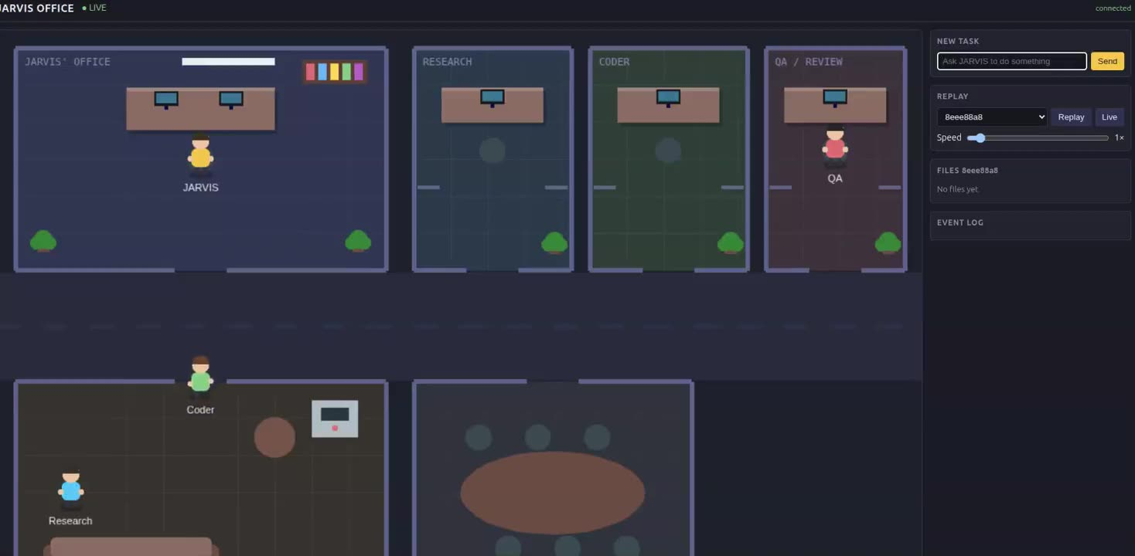
IN DEVELOPMENT: OPENCLAW AND DISCORD
JARVIS: a local agent team
A boss agent hands work to Research, Coder and QA agents.
Runs locally on ollama/qwen2.5:7b, controlled from Discord through OpenClaw.
44 tool definitions make prompt processing the bottleneck on a CPU (from my posts).
Gateway bound to loopback; the bot token lives in an environment variable (from my posts).
No public source and no latency benchmarks yet.
Video on the site
7 / 16

Slide 8
IN DEVELOPMENT: BUILT AND PLANNED
RAG research
Built: a 16-chapter FastAPI, PostgreSQL and React learning playbook, re-run with 9, then 11, then 14 tests.
Built: tests ran on SQLite and fakeredis; the Postgres-only SQL was never run on a live server.
Planned: one PostgreSQL database for referrals that arrive by fax, phone and email.
Planned: hybrid search and a reranker for monthly reporting, with a local embedding model and LLM.
The referral system is a design only. No results are claimed.
8 / 16

Slide 9
CHANNEL ACCESS: METHOD ONLY
Networked ML and RL algorithm
Five strategies in the code: slotted-ALOHA baseline, Q-learning, adaptive step size, a hybrid of the two, and a UCB bandit.
Each device sets its own transmit probability; plots compare the strategies with the 1/e slotted-ALOHA line.
A fairness term nudges devices on long success streaks to back off.
No measured results are published, and there are no automated tests.
9 / 16

Slide 10
FULL STACK
Restaurant app
Flask and MySQL restaurant database with CRUD screens.
Face-recognition sign-in using OpenCV; it matches one known staff face only.
A console chatbot answers questions about the data; its read-only rule is enforced by its prompt, not by database permissions.
No automated tests. Demoed on video.
10 / 16

Slide 11
LUAU WITH PROFESSIONAL TOOLING
Roblox games
Riposte: a 1v1 melee duel built on parry and step-out timing.
Pet Cafe Tycoon: a multi-floor tycoon in development, with a public repository: https://github.com/graftonatwit/pet-cafe-tycoon
Both are built with Rojo, with Lune or TestEZ tests on the pure logic.
Steal a Dinosaur: in development, not launched; source private.
Riposte has not been playtested by a human yet.
11 / 16

Slide 12
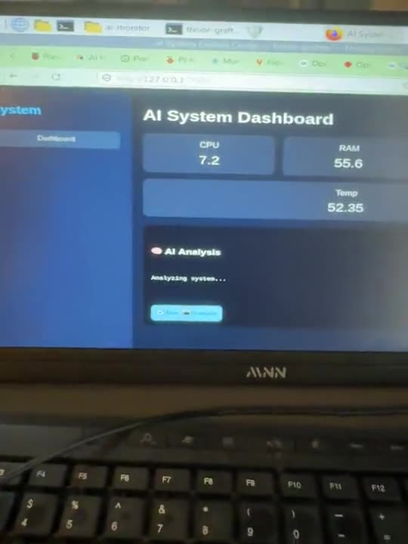
RASPBERRY PI 5
Homelab
File-backed: a system dashboard (psutil and Flask) that asks a local Ollama model for analysis on manual refresh; the AI-System-Monitor repo is public.
From my post only: Pi-hole DNS filtering and a local AI outfit check fed by a Tapo camera.
Plans only: a redundant storage array and a backup target.
Video on the site
12 / 16

Slide 13
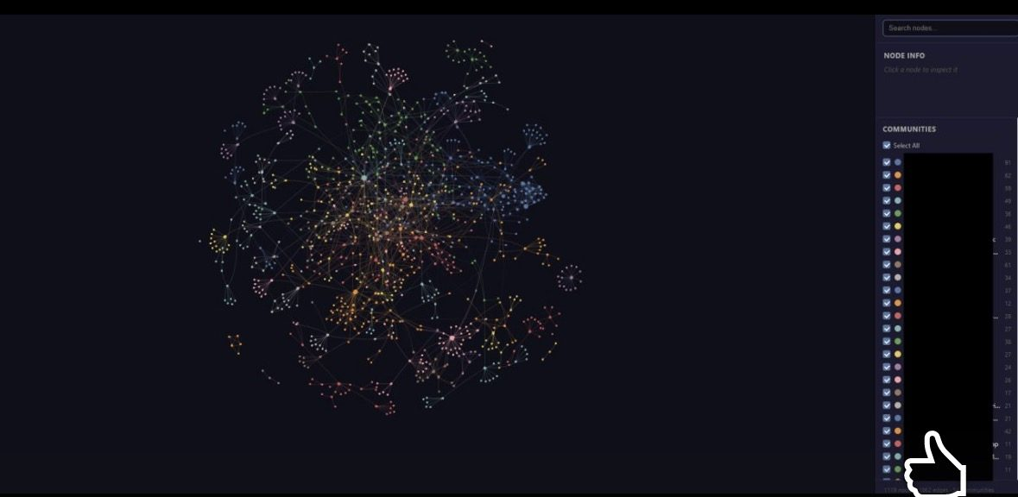
KEY NUMBERS
Impact
Claim | Value
Alex savings | ~$20K/yr (projected)
Alex cost per call minute | ~$0.05/min (measured)
Alex action surface | 3 verbs (code-verified)
Fewer tokens querying the map first (one test) | ~76% (measured)
Knowledge-graph view of a project with the community list blacked out
13 / 16

Slide 14
BEYOND THE FEATURED WORK
More projects
MLB game predictor: Elo, calibrated logistic regression and XGBoost in a daily pipeline; about 57% test accuracy against a 52.9% home-team baseline (June 2026 notes); the market still beats the model alone.
Clinic Referral Tracker: Scrum Master and Product Owner on a three-person course team; requirements done, app not built yet.
Personal finance tracker: a Python command-line app with SQLite, pandas and matplotlib.
Earlier builds: ten small public repos (routers, servers, games, labs) linked on the site.
14 / 16

Slide 15
WATCH THEM RUN
Demo videos
Restaurant management app demo: https://youtu.be/mkLY7o9TAsI
West End Redevelopment VR demo: https://youtu.be/Cj0fLZzFD_E
The deck cannot play video; both links open on YouTube.
15 / 16

Slide 16
LET'S TALK
Contact
trevorjgrafton@gmail.com
https://www.linkedin.com/in/trevor-grafton-85941533b/
github.com/graftonatwit
Greater Boston
Spring 2027: seeking a co-op (January to May or June)
Summer 2027: seeking part-time work (May to August)
Fall 2027: seeking full-time roles (September start)
Resume: download the PDF from the site.
16 / 16

